Slide 1
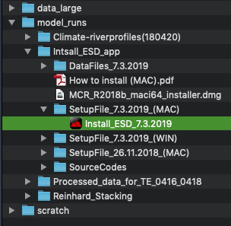
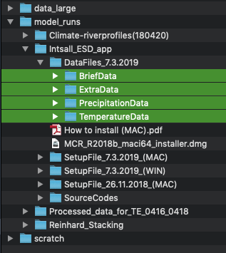
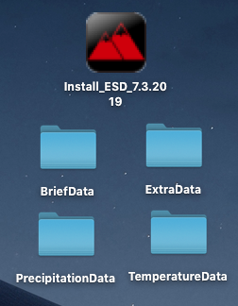
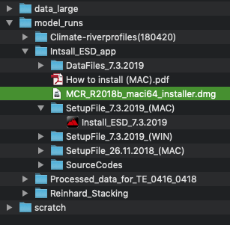
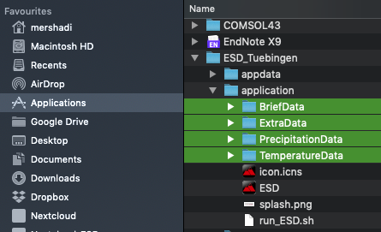
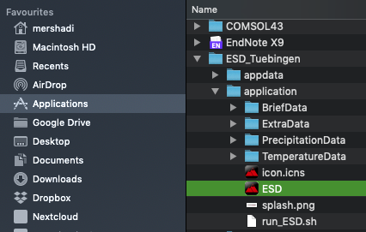
Install on MAC
*If you already have an older version of this app, please delete ESD_Tuebingen folder and all its subfolders from the applications.
To install:
1- Go to the link below and copy "Install_ESD_7.3.2019" on your desktop. (figure 1)
\\134.2.5.43\esd01\data\mershadi\model_runs\Intsall_ESD_app\SetupFile_7.3.2019_(MAC)
2- Go to the link below and copy all the subfolders on your desktop. (figure 2)
\\134.2.5.43\esd01\data\mershadi\model_runs\Intsall_ESD_app\DataFiles_7.3.2019
* You should have four folders and one installation file on your desktop. (figure 3)
3- To install and run this program you need MATLAB RUNTIME (2018b 64bit) installed on your OS.
* It is free and if you do not have it, the program automatically can download and install it.
* You can also download and install it from MATLAB website:
https://de.mathworks.com/products/compiler/matlab-runtime.html
* You can install it by running "MCR_R2018b_maci64_installer" at the link below: (figure 4)
\\134.2.5.43\esd01\data\mershadi\model_runs\Intsall_ESD_app
3- Run "Install_ESD_7.3.2019" on your desktop to install the program.
* Leave the installation path as it is (Applications/ESD_Tuebingen).
5- When you installed the app successfully, copy all the data folders (BriefData, ExtraData, PrecipitationData, TemperatureData) to the path below: (figure 5)
/Applications/ESD_Tuebingen/application
6- Now run the "ESD" from the link below: (figure 6)
“/Applications/ESD_Tuebingen/application”
Figure 1
Figure 2
Figure 3
Figure 4
Figure 5
Figure 6

